Slide 1
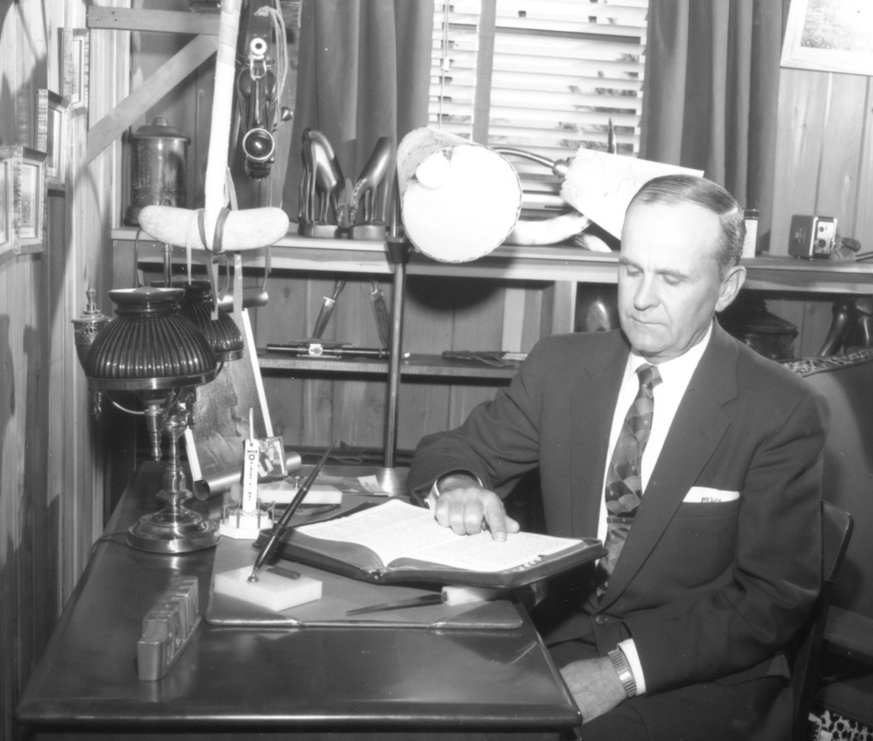
Living Prophecy When Satan Steps into Flesh
#5

Slide 2
THIS EVENING 1.) Who is the Woman in Rev 12? 2.) When does Satan have his throne? 3.) Where is the Bride when these things are happening?

Slide 3
LUKE 21 : 26 - 32
. . . redemption draws nigh . . .

Slide 4
REVELATION 12 : 1 - 5
. . . the Woman in travail . . .

Slide 5
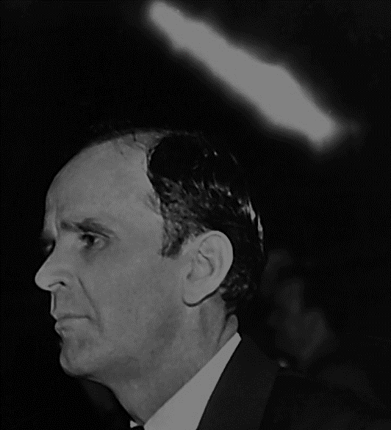
57-0821 Hebrews, Chapter One
28 Now, the woman represented the Church, and the Child that she brought forth was Christ. The moon under her feet was the law, the sun at her head was grace. …

Slide 6
57-0821 Hebrews, Chapter One
… And there’s where, at what…The twelve apostles was the glory or the crowning of the New Testament. See?

Slide 7
REVELATION 12 : 6
. . . restoration of the Jews . . .

Slide 8
DEUTORONOMY 32 : 8 - 12
. . . promise of Jacob . . .

Slide 9
63-0323 The Sixth Seal
224 And, remember, as long as Israel is out of that land, she is out of the will of God; like Abraham, who it was give to. And when…

Slide 10
63-0323 The Sixth Seal
225 They wouldn’t get on that plane. They didn’t never see anything like that. There was an old rabbi stepped down there, said, “Our prophet told us, that, when Israel went home, it would be ‘on the wings of an eagle,’” on the plane, a way home.

Slide 11
63-0323 The Sixth Seal
226 There she is now, building. The fig tree restoring! Amen! The old six-point star of David flying!

Slide 12
63-0323 The Sixth Seal
227 “The Gentile days numbered, with harrows encumbered!” The Tribulation period right at hand!

Slide 13
63-0323 The Sixth Seal
228 And standing right here, and the Seals being opened, the Church ready to take Her flight in the air!

Slide 14
REVELATION 12 : 7 – 10
. . . Satan cast out of Heaven . . .

Slide 15
63-0321 The Fourth Seal
On the earth, he is Satan, representative, on the earth, that he now is head of the kingdoms of the world, the very same kingdoms that he offered to the Lord Jesus in Matthew 4. Satan now becomes a full king.

Slide 16
63-0321 The Fourth Seal
183 Now, this happens later on. He is false prophet now. He will become beast, after a while, when he breaks his covenant there with the Jews.

Slide 17
63-0321 The Fourth Seal
.. You know how we…All right, notice now, he’ll be given a heart of a beast, at that time, and Satan will incarnate himself. Because, when the Church goes up, Satan is cast out. See? See? It’s done, then, it’s, all of his accusing is done.

Slide 18
63-0321 The Fourth Seal
184 Look, as long as the Intercessor is still on the Throne, Satan can stand there and accuse, because he is the attorney of the other side. He is the opponent of Christ. …

Slide 19
63-0321 The Fourth Seal
And Christ is… He is standing there, the opponent is standing there, saying, “But, wait! Adam fell! Adam done this! I conquered him. I got his wife to believe a lie. And You said she would be damned by it. I got it!”

Slide 20
63-0321 The Fourth Seal
185 But here is the Mediator standing there, amen, the Kinsman Redeemer, amen, stand there with the Blood that can take the vilest sinner’s heart and change it. The Mediator is on the Throne. Yes, sir.

Slide 21
Satan Incarnate - TRIPLE POWERS Political, Religious & Demon - TRIPLE CROWN Heaven, Purgatory & Earth - TRIPLE HORSE White, Red & Black (Pale horse)

Slide 22
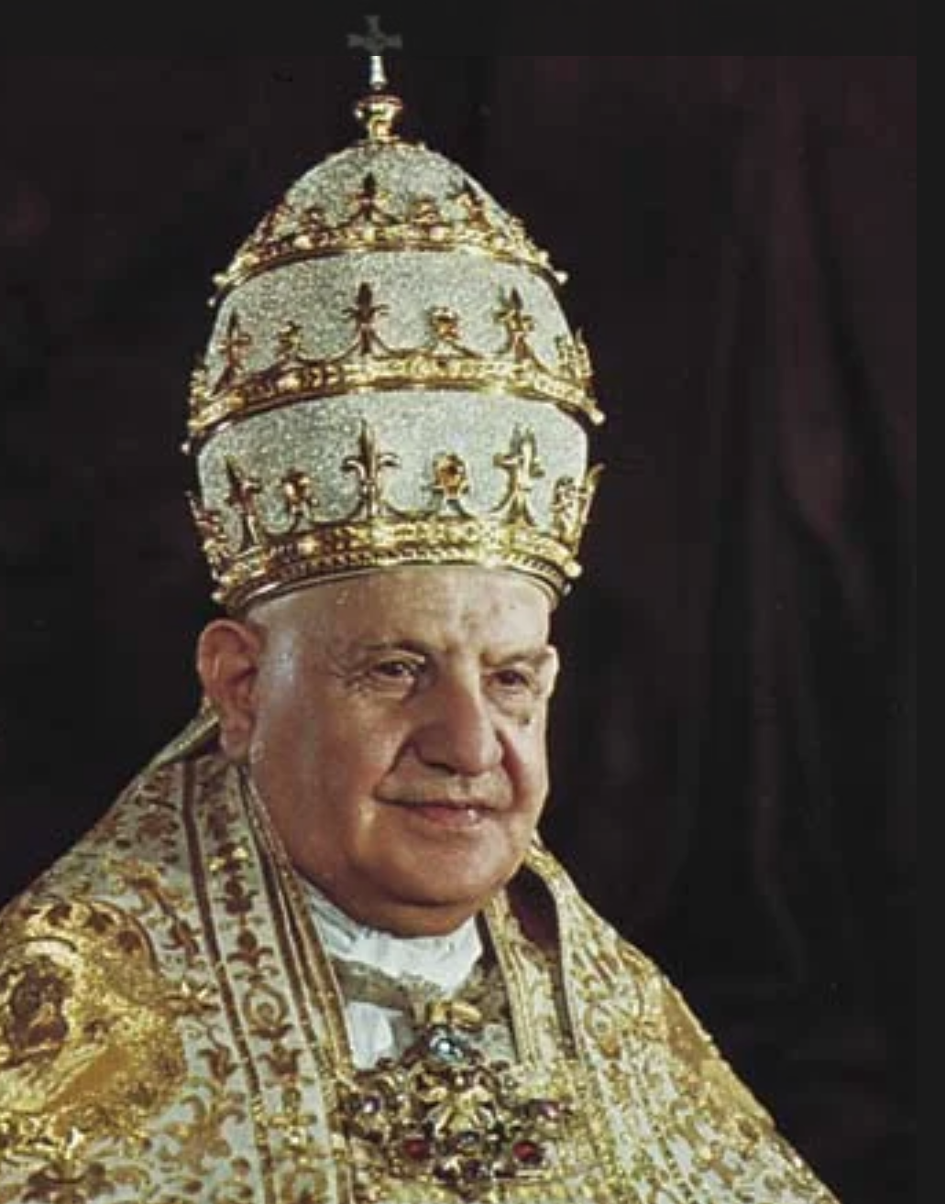
Pope John Paul XXIII (13th)

Slide 23
Triregnum Latin for “triple reign”

Slide 24
BRITANNICA.COM
As a ceremonial piece, the triregnum signified the triple pontifical power as expressed during a pope’s coronation: father of kings, governor of the world, and vicar of Christ. According to tradition, the triregnum also represents the three states of the Roman Catholic Church:

Slide 25
BRITANNICA.COM
… the church militant (which refers to the church on Earth), the church penitent (also called the church suffering or the church expectant, referring to the souls in purgatory), and the church triumphant (which refers to the saints in heaven).

Slide 26
WHAT WE COVERED 1.) Who is the Woman in Rev 12? 2.) When does Satan have his throne? 3.) Where is the Bride when these things are happening?

Slide 27
Living Prophecy When Satan Steps into Flesh
#5

